Slide 1


Email to Artificial Intelligence Design Phase Scott Burdick Michael Celesti Daniel Chong John Garrett
The Problem
It is difficult to organize, share, and track information
Value Proposition
AI data processing emails for user and team organization
Provides file sharing, and team analytics
Target market
Enterprise Licenses
Free use for Universities, Households
Missed deadlines, time wasted searching through old emails, and anxiety

Slide 2
Key Feature Comparison
Function |  | Clean Email | SaneBox | ActiveInbox | Sharepoint
Sorting Schema | Email content-based sorting | Email header-based sorting | Email content-based sorting | Task-based sorting | Only direct chat messaging
Collaboration Functionality | Multi-User, All email providers | Single user, all email providers | Single user, all email providers | Single User, Gmail | Multi-User, No email support
Data Analytics | Team Analytics | None | None | None | Team Analytics
File Management | Cloud Storage, team fileshare | None | Cloud storage | None | Cloud Storage, team fileshare
User Cost | Free to Use | $10/month | $7/month | $4.16/month | $5/month
Enterprise Cost | $ | N/A | N/A | N/A | $$$

Slide 3
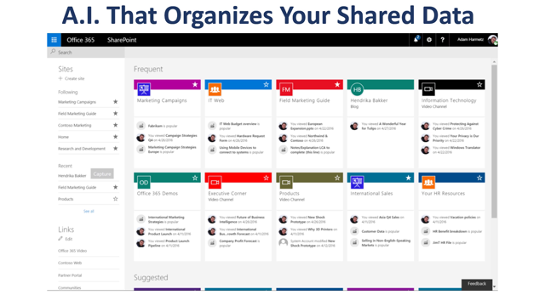

Slide 4
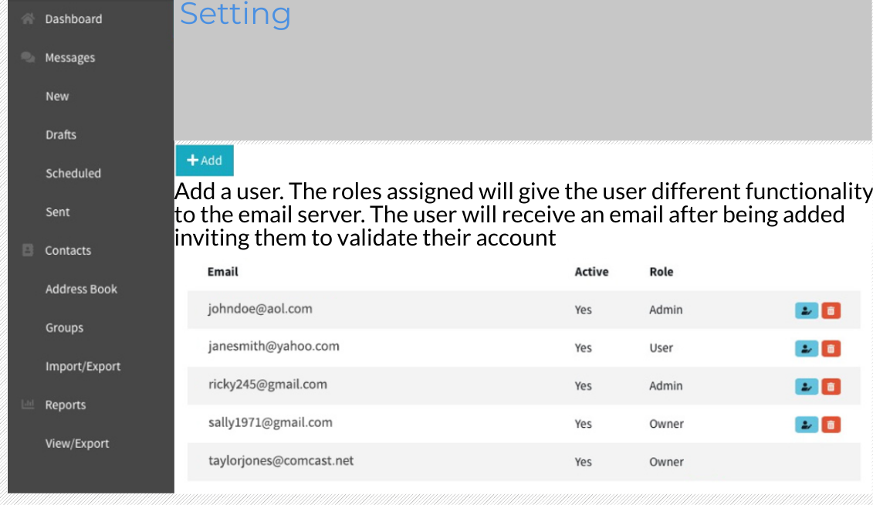
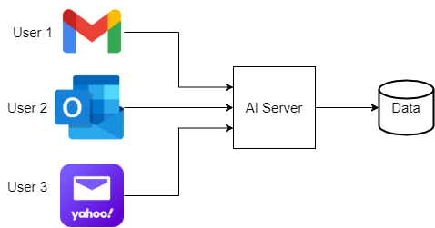
Collaboration Functionality
Multi-users
Accessible for many users
Headquarter of shared knowledge
Multi-email providers
Convenient for a variety of email users

Slide 5
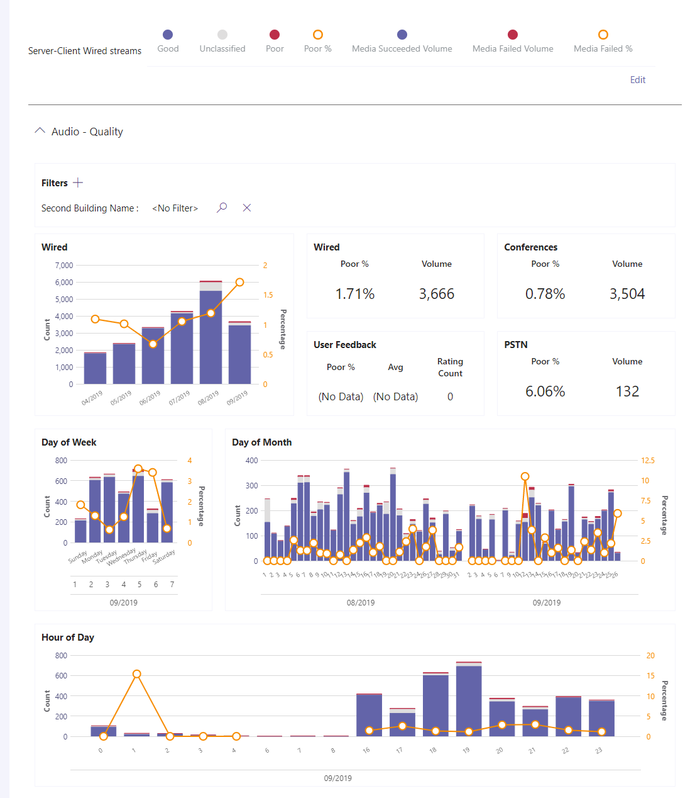
Data Analytics For Organizations
Data Analytics to help the team evaluate their communication effectiveness & tool utilization
Metrics include (separated by project):
Average Email turnover time
Auto-populated Deadline tracking
Number of daily/weekly/monthly client engagements
File sharing summary
Estimated time save for organizations

Slide 6



Implementation Plans and Conclusion
1. Develop AI sorter
2. Create web frontend
3. Write Python analytics script

